Slide 1
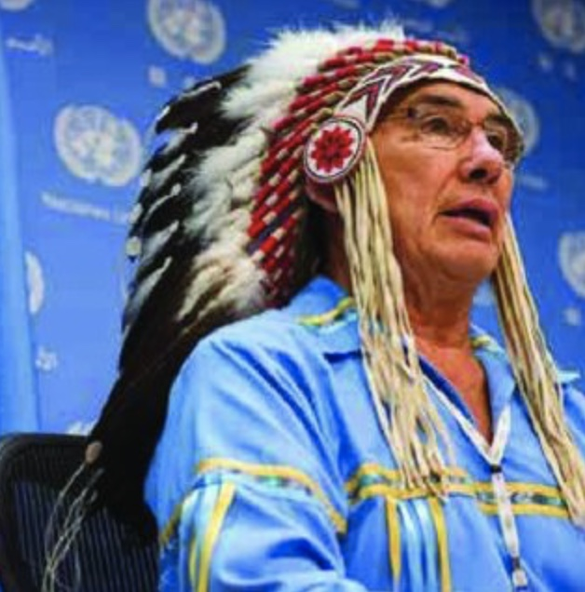
FIRST NATION CHILD & FAMILY LAW
Presentation by: Dr. Wilton Littlechild, International Chief
February 11, 2020

Slide 2
INTRODUCTION AND OUTLINE
Siksika Nation “Every Child Matters”
TRC Calls to Action
Children have Treaty rights too
International Laws, Norms and Standards
Treaty
UN Declaration on the Rights of Indigenous Peoples
Articles 1 & 3
Convention on Rights of the Child – Comment 11
OAS Declaration on the Rights of Indigenous Peoples (Family, laws)
ILO C169 - CERD
The Right to Play – Children have the Right to be Happy!

Slide 3
THE TRC OF CANADA CALL TO ACTION No. 4 CALLED FOR FEDERAL LEGISLATION
WE CALL UPON THE FEDERAL GOVERNMENT TO ENACT ABORIGINAL CHILD-WELFARE LEGISLATION THAT ESTABLISHES NATIONAL STANDARDS FOR ABORIGINAL CHILD APPREHENSION AND CUSTODY CASES AND INCLUDES PRINCIPLES THAT:
AFFIRM THE RIGHT OF ABORIGINAL GOVERNMENTS TO ESTABLISH AND MAINTAIN THEIR OWN CHILD-WELFARE AGENCIES.
REQUIRE ALL CHILD-WELFARE AGENCIES AND COURTS TO TAKE THE RESIDENTIAL SCHOOL LEGACY INTO ACCOUNT IN THEIR DECISION-MAKING.
ESTABLISH, AS AN IMPORTANT PRIORITY, A REQUIREMENT THAT PLACEMENTS OF ABORIGINAL CHILDREN INTO TEMPORARY AND PERMANENT CARE BE CULTURALLY APPROPRIATE.

Slide 4
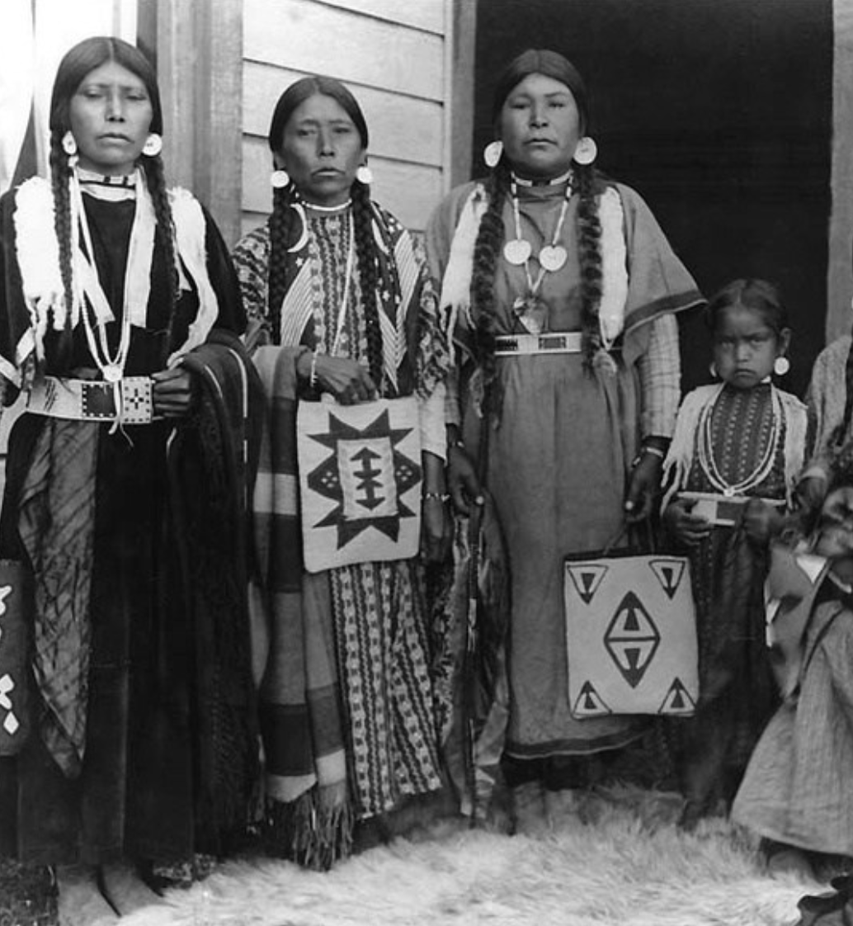
UN Declaration on the Rights of Indigenous Peoples
Pp
Recognizing in particular the right of indigenous families and communities to retain shared responsibility for the upbringing, training, education and well-being of their children, consistent with the rights of the child,
Recognizing the urgent need to respect and promote the inherent rights of indigenous peoples which derive from their political, economic and social structures and from their cultures, spiritual traditions, histories and philosophies, especially their rights to their lands, territories and resources

Slide 5
Treaties Preambular Paragraphs
Considering that the rights affirmed in treaties, agreements and other constructive arrangements between States and indigenous peoples are, in some situations, matters of international concern, interest, responsibility and character.
Considering also that treaties, agreements and other constructive arrangements, and the relationship they represent are the basis for a strengthened partnership between indigenous peoples and States.

Slide 6
Article 14
Indigenous peoples have the right to establish and control their educational systems and institutions providing education in their own languages, in a manner appropriate to their cultural methods of teaching and learning.
Indigenous individuals, particularly children, have the right to all levels and forms of education of the State without discrimination.
States shall, in conjunction with indigenous peoples, take effective measures, in order for indigenous individuals, particularly children, including those living outside their communities, to have access, when possible, to an education in their own culture and provided in their own language.

Slide 7
Article 21
Indigenous peoples have the right, without discrimination, to the improvement of their economic and social conditions, including, inter alia, in the areas of education, employment, vocational training and retraining, housing, sanitation, health and social security.
States shall take effective measures and, where appropriate, special measures to ensure continuing improvement of their economic and social conditions. Particular attention shall be paid to the rights and special needs of indigenous elders, women, youth, children and persons with disabilities.

Slide 8
Article 24
Particular attention shall be paid to the rights and special needs of indigenous elders, women, youth, children and persons with disabilities in the implementation of this Declaration.
States shall take measures, in conjunction with indigenous peoples, to ensure that indigenous women and children enjoy the full protection and guarantees against all forms of violence and discrimination.

Slide 9
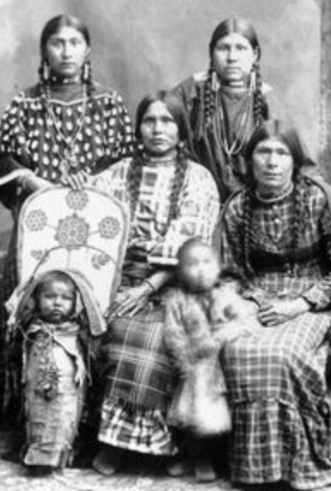
Convention of the Rights of the Child Comment No. 11 “Indigenous children and their rights under the Convention”
Indigenous children are entitled to, and should enjoy, the same level of rights afforded non- indigenous children as outlined in the Convention. States should work to strengthen connections and cooperation with indigenous communities to empower indigenous children to express their rights.
The Best Interest of the Child
Fundamental focus on culture
Respect for the views of the child
Links with other international laws
Consider incorporating by reference or including Common 11 in First Nation’s own law

Slide 10
OAS Declaration on the Rights of Indigenous Peoples
Article XVII. Indigenous family
The family is a natural and fundamental group unit of society. Indigenous peoples have the right to preserve, maintain, and promote their own family systems. States shall recognize, respect, and protect the various indigenous forms of family, in particular the extended family, as well as the forms of matrimonial union, filiations, descent, and family name. In all cases, gender and generational equity shall be recognized and respected.

Slide 11
In matters relating to custody, adoption, severance of family ties, and related matters, the best interests of the child shall be a primary consideration. In determining the best interests of the child, courts and other relevant institutions shall take into account the right of every indigenous child, in community with member of his or her people, to enjoy his or her own culture, to profess and practice his or her own religion or to use his or her own language and in that regard shall look to the indigenous law of the peoples concerned and shall consider their points of view, rights and interest, including the positions of individuals, the family, and the community.

Slide 12
Article XXII. Indigenous law and jurisdiction
Indigenous peoples have the right to promote, develop and maintain their institutional structures and their distinctive customs, spirituality, traditions, procedures, practices and, in the cases where they exist, juridical systems or customs, in accordance with international human rights standards.
The indigenous law and legal systems shall be recognized and respected by the national, regional and international legal systems.
The matters referring to indigenous persons or to their rights or interests in the jurisdiction of each state shall be conducted so as to provide for the right of the indigenous people to full representation with dignity and equality before the law. Consequently, they are entitled, without discrimination, to equal protection and benefit of the law, including the use of linguistic and cultural interpreters.
The States shall take effective measures in conjunction with indigenous peoples to ensure the implementation of this article.

Slide 13
Article XXIV. Treaties, agreements, and other constructive arrangements
Indigenous peoples have the right to the recognition, observance, and enforcement of the treaties, agreements and other constructive arrangements concluded with states and their successors, in accordance with their true spirit and intent in good faith and to have the same be respected and honored by the States. States shall give due consideration to the understanding of the indigenous peoples as regards to treaties, agreements and other constructive arrangements.
When disputes cannot be resolved between the parties in relation to such treaties, agreements and other constructive arrangements, these shall be submitted to competent bodies, including regional and international bodies, by the States or indigenous peoples concerned.
Nothing in this Declaration may be interpreted as diminishing or eliminating the rights of indigenous peoples contained in treaties, agreements and other constructive arrangements.

Slide 14
Willie’s Bill of Rights for Kokums
You have the right to be you – the way you are, the way you want to be
You have the right to grow, to change, to become, to strive, to reach for any goal, to be limited only by your degree of talent and amount of effort
You have the right to privacy – in a marriage, in a family, in any relationship, in any group – the right to keep a part of your life secret, no matter how trivial or how important, merely because you want it to be that way. And you have the right to be alone part of each day, each week and each year, to spend time with yourself
You have the right to be loved and to love, to be accepted, cared for and adored; and you have the right to fulfill that right

Slide 15
5. You have the right to ask questions of anyone, at any tine, in any matter that affects your life, so long as it is your business to do so, and to be listened to and taken seriously
You have the right to self-respect and to do everything you need to do to increase your self-esteem so long as you hurt no one in doing so
You have the right to be happy, to find something in the world that is meaningful and rewarding to you and gives you a sense of completeness
You have the right to be trusted and to trust and to be taken at your word. If you were wrong, you have the right to be given a chance to make good, if possible
You have the right to be free as long as you as you act responsibly and are mindful of the rights of others and of those obligations that you entered into freely
You have the right to wibm to succeed, to make plans, to see those plans fulfilled, to become the best you that you can possibly become

Slide 16
Mayan Ceremony and Prophesies
Good-bye to Grandfather Sun and Hello to Baby Sun – 5000 Year Old Calendar
Things will get better for Indigenous Peoples if four things happen:
Spirituality must come back to leadership
Women will take a more prominent role in leadership
We must build on the strengths of our peoples
We must work very, very hard on Unity

Slide 17
QUESTIONS? Hai, Hai

Slide 18
UN Declaration
CRC 11(

