Slide 1
Bill C-92: An Act respecting First Nations, Inuit and Métis children, youth and families
Paul Seaman, partner
Bill C-92 Technical Meeting – Treaty 7 Territory

Slide 2
Agenda
Topic
1. Brief Background – Bill C-92
2. Overview of Jurisdictional Sections
- Definition of “indigenous governing body”
- Section 20, Coordination Agreements
- Section 21, “Force of Law”
- Sections 22, 24, “Conflicts”
3. Emerging practical and legal issues

Slide 3
Bill C-92 – brief history
“Co-development” effort as between Canada, provinces, and Indigenous people
Larger context of FN Caring Society’s funding case before the Canadian Human Rights Tribunal, Jordan’s Principle, and promise to implement UNDRIP
Delegated agencies limited by the extent of provincial delegation
Includes new principles; provincial bills also contemplated (Bill 26 in BC)
Contemplates regulations in a number of instances - Indigenous peoples must be afforded “a meaningful opportunity to collaborate in the policy development leading to the making of the regulations”

Slide 4
BILL C-92 – brief history
Came into force Jan 1, 2020, but does not apply until “indigenous governing body” provides Minister with notice and/or requests a coordination agreement
Positives: lauded for making the best interests of Indigenous child front and center in services and instances of apprehension
Also for prioritizing placing an Indigenous child taken into care with their own family and Indigenous community
Criticized for unclear funding arrangements; potential to allow for multiple levels of laws to apply at once (federal, provincial/territorial, Indigenous)

Slide 5
BILL C-92 – OVerview
Definition of “indigenous governing body”:
Indigenous governing body means a council, government or other entity that is authorized to act on behalf of an Indigenous group, community or people that holds rights recognized and affirmed by section 35 of the Constitution Act, 1982.

Slide 6
BILL C-92 – OVerview
Section 20:
20 (1) If an Indigenous group, community or people intends to exercise its legislative authority in relation to child and family services, an Indigenous governing body acting on behalf of that Indigenous group, community or people may give notice of that intention to the Minister and the government of each province in which the Indigenous group, community or people is located.
Coordination agreement
(2) The Indigenous governing body may also request that the Minister and the government of each of those provinces enter into a coordination agreement with the Indigenous governing body in relation to the exercise of the legislative authority, respecting, among other things,

Slide 7
BILL C-92 – OVerview
Section 20:
(c) fiscal arrangements, relating to the provision of child and family services by the Indigenous governing body, that are sustainable, needs-based and consistent with the principle of substantive equality in order to secure long-term positive outcomes for Indigenous children, families and communities and to support the capacity of the Indigenous group, community or people to exercise the legislative authority effectively; …

Slide 8
BILL C-92 – OVerview
Section 20(3) – Indigenous law comes into force when coordination agreement is entered into, or if “reasonable efforts” have been made to do so an a year has passed
Then Sections 21 (force of law) and 22 and 24 (conflicts) apply:
22 (1) If there is a conflict or inconsistency between a provision respecting child and family services that is in a law of an Indigenous group, community or people and a provision respecting child and family services — other than any of sections 10 to 15 of this Act and the provisions of the Canadian Human Rights Act — that is in a federal Act or regulation, the provision that is in the law of the Indigenous group, community or people prevails to the extent of the conflict or inconsistency.

Slide 9
BILL C-92 – OVerview
(3) For greater certainty, if there is a conflict or inconsistency between a provision respecting child and family services that is in a law of an Indigenous group, community or people and a provision respecting child and family services that is in a provincial Act or regulation, the provision that is in the law of the Indigenous group, community or people prevails to the extent of the conflict or inconsistency.
24 (1) If there is a conflict or inconsistency between a provision respecting child and family services that is in a law of an Indigenous group, community or people and a provision respecting child and family services that is in a law of another Indigenous group, community or people, the provision that is in the law of the Indigenous group, community or people with which the child has stronger ties — taking into consideration his or her habitual residence as well as his or her views and preferences, giving due weight to his or her age and maturity, unless they cannot be ascertained, and the views and preferences of his or her parent and the care provider — prevails to the extent of the conflict or inconsistency.

Slide 10
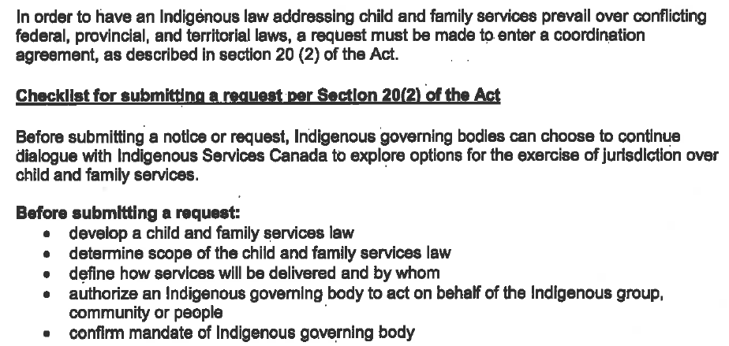
Bill C-92 – legal and practical issues
ISC issued a “Technical Guide” on December 1, 2019 - page 26:

Slide 11
BILL C-92 – LEGAL and practical issues
New principles, recognition of self-government/jurisdiction on children and families
Funding uncertainties remain
Potential for uncertain application of federal, provincial, other Indigenous laws
May be regulation-heavy; degree of further consultation on regs unclear

Slide 12
Paul Seaman
Partner
Indigenous Resource Law
Paul.Seaman@gowlingwlg.com
+1 604 891 2731

